Slide 1
Recurrences & Master Method
Course Code: CSC 2211
Course Title: Algorithms
Dept. of Computer Science
Faculty of Science and Technology
Lecturer No: | 03 | Week No: | 03 | Semester:
Lecturer: | Name & email: Dr. Abdus Salam, abdus.salam@aiub.edu
Slides are adopted from A/Prof. Mashiour Rahman [Associate Dean, FST]

Slide 2
Recurrences
Running times of algorithms with recursive calls can be described using recurrences.
A recurrence is an equation or inequality that describes a function in terms of its value on smaller inputs.
For divide and conquer algorithms:
Example: Merge Sort

Slide 3
The divide- and- conquer design paradigm
1. Divide the problem (instance) into subproblems.
2. Conquer the subproblems by solving them recursively.
3. Combine subproblem solutions.

Slide 4
The divide- and- conquer design paradigm
Example: merge sort
1. Divide: Trivial (array is halved).
2. Conquer: Recursively sort 2 subarrays.
3. Combine: Linear- time merge.
Recurrence for merge sort
Let T( n ) = Time required for size n
T( n ) =
Sub-problem
Size (n/2)
2
*
T( n / 2)
+
O( n)
Number Of Subproblems
*
Time required for each Subproblem
Work Dividing and Combining
+

Slide 5
The divide- and- conquer design paradigm
Binary search
Find an element in a sorted array:
1. Divide: Check middle element.
2. Conquer: Recursively search 1 subarray.
3. Combine: Trivial.
Recurrence for binary search
T( n) =
1
*
T( n / 2)
+
Θ(1)
Number Of Subproblems
Time required for each Subproblem
Work Dividing and Combining
*
+

Slide 6
Solving Recurrences
Repeated (backward) substitution method
Expanding the recurrence by substitution and noticing a pattern (this is not a strictly formal proof).
Substitution method
guessing the solutions
verifying the solution by the mathematical induction
Recursion-trees
Master method
templates for different classes of recurrences

Slide 7
Repeated Substitution
Let’s find the running time of the merge sort
T(n) = 2T(n/2) + n substitute
= 2(2T(n/4) + n/2) + n expand
= 2²T(n/4) + 2n substitute
= 2²(2T(n/8) + n/4) + 2n expand
= 2³T(n/8) + 3n observe pattern
= 2³T(n/2³) + 3n observe pattern
T( n ) = 2^{k}T(n/2^{k}) + kn
= n T(n/n) + n lg n
= n + n lg n
assume 2^{k-1}< n ≤ 2^{k}.
So upper bound for k is
n = 2^{k}
K = log₂n = lg n
T(n) = O(nlgn)

Slide 8
Repeated Substitution
The procedure is straightforward:
Substitute, Expand, Substitute, Expand, …
Observe a pattern and determine the expression after the k-th substitution.
Find out what the highest value of k (number of iterations, e.g., lg n) should be to get to the base case of the recurrence (e.g., T(1)).
Insert the value of T(1) and the expression of k into your expression.

Slide 9
Repeated Substitution (Example)
assume 2^{k-1}< n ≤ 2^{k}.
So upper bound for k is
n = 2^{k}
K = log₂n = lg n
T(n) = 2T(n/2) + 2n + 3 substitute
= 2(2T(n/4) + n + 3) + 2n +3 expand
= 2²T(n/4) + 4n + 2x3 + 3 substitute
= 2²(2T(n/8) + n/2 + 3) + 4n + 2x3 + 3 expand
= 2³T(n/2³) + 2x3n + 3x(2²⁺2¹⁺2⁰) observe pattern
T(n) = 2^{k}T(n/2^{k}) + 2nk + 3
= 2^{k}T(n/2^{k}) + 2nk + 3 (2^{k}-1)
= nT(n/n) + 2n lg n + 3(n - 1)
= 2n+2n lg n + 3n - 3
= 5n + 2n lg n – 3
T(n) = O(nlgn)

Slide 10
Substitution Method
The substitution method to solve recurrences entails two steps:
Guess the solution.
Use induction to prove the solution.
Example:
T(n) = 4T(n/2) + n

Slide 11
Substitution Method
T(n) = 4T(n/2) + n
1) Guess T(n) = O(n³), i.e., T(n) is of the form cn³
2) Prove T(n) ≤ cn³ by induction
T(n) = 4T(n/2) + n recurrence
≤ 4c(n/2)³ + n induction hypothesis
= 0.5cn³ + n simplify
= cn³ – (0.5cn³ – n) rearrange
≤ cn³ if c>=2 and n>=1
Thus T(n) = O(n³)

Slide 12
Substitution Method
Tighter bound for T(n) = 4T(n/2) + n:
Try to show T(n) = O(n²)
Prove T(n) ≤ cn² by induction
T(n) = 4T(n/2) + n
≤ 4c(n/2)² + n
= cn² + n
≤ cn²

Slide 13
Substitution Method
What is the problem? Rewriting
T(n) = O(n²) = cn² + (something positive)
As T(n) ≤ cn² does not work with the inductive proof.
Solution: Strengthen the hypothesis for the inductive proof:
T(n) ≤ (answer you want) - (something > 0)

Slide 14
Substitution Method
Fixed proof: strengthen the inductive hypothesis by subtracting lower-order terms:
Prove T(n) ≤ cn² - dn by induction
T(n) = 4T(n/2) + n
≤ 4(c(n/2)² – d(n/2)) + n
= cn² – 2dn + n
= (cn² – dn) – (dn – n)
≤ cn² – dn if d ≥ 1

Slide 15
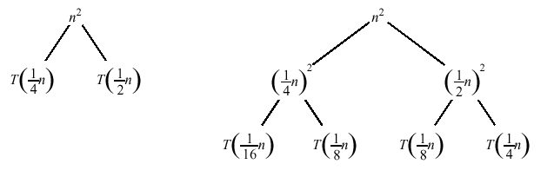
Recursion Tree
A recursion tree is a convenient way to visualize what happens when a recurrence is iterated.
Good for ”guessing” asymtotic solutions to recurrences

Slide 16
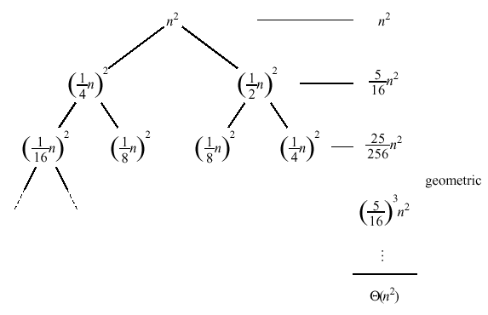
Recursion Tree

Slide 17
Master Method
The idea is to solve a class of recurrences that have the form
T(n) = aT(n/b) + f(n)
Assumptions: a ≥ 1 and b > 1, and f(n) is asymptotically positive.
Abstractly speaking, T(n) is the runtime for an algorithm and we know that
a number of subproblems of size n/b are solved recursively, each in time T(n/b).
f(n) is the cost of dividing the problem and combining the results. e.g., In merge-sort .

Slide 18
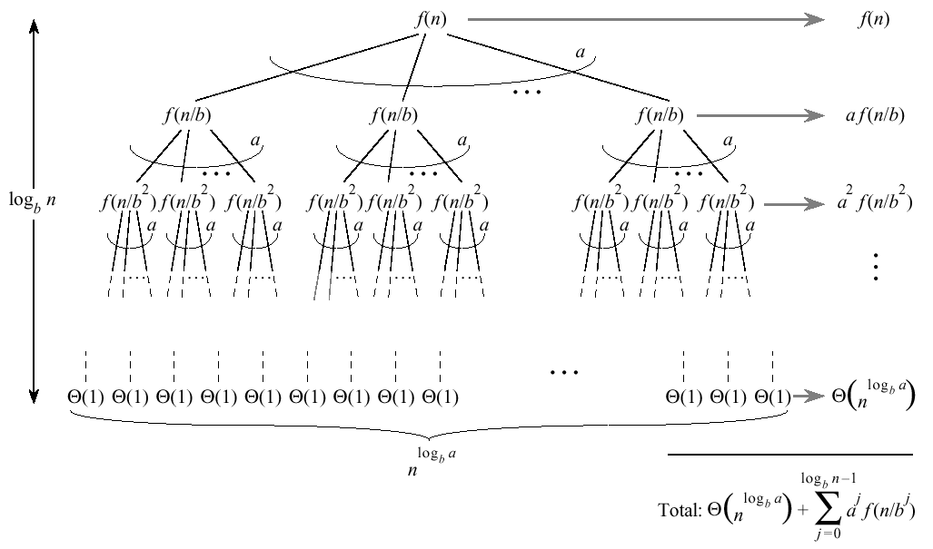
Master Method
Split problem into a parts. There are log_{b}n levels. There are leaves.

Slide 19
Master Method
Iterating the recurrence (expanding the tree) yields
T(n) = f(n) + aT(n/b)
= f(n) + af(n/b) + a²T(n/b²)
= f(n) + af(n/b) + a²f(n/b²) + …
a^{log}b^{n-1}f(n/b^{log}b^{n-1}) + a^{log}b^{n}T(1)
T(n) =
The first term is a division/recombination cost (totaled across all levels of the tree).
The second term is the cost of doing all subproblems of size 1 (total of all work pushed to leaves).

Slide 20
Master Method
Three common cases:
Running time dominated by cost at leaves.
Running time evenly distributed throughout the tree.
Running time dominated by cost at the root.
To solve the recurrence, we need to identify the dominant term.
In each case compare with

Slide 21
Master Method, Case 1
If for some constant then
f(n) grows polynomially slower than (by factor ).
The work at the leaf level dominates
Cost of all the leaves

Slide 22
Master Method, Case 2
If then
and are asymptotically the same
The work is distributed equally throughout the tree
(level cost)(number of levels)

Slide 23
Master Method, Case 3
If for some constant then
Inverse of Case 1
f(n) grows polynomially faster than
Also need a “regularity” condition
The work at the root dominates
division/recombination cost

Slide 24
Master Method, Summarized
Given: recurrence of the form

Slide 25
Examples Master Method
Extract a, b, and f(n) from a given recurrence
Determine n^{log}b ª
Compare f(n) and n^{log}b ª asymptotically
Determine appropriate MT case and apply it
Merge sort: T(n) = 2T(n/2) + Θ(n)
1. a=2, b=2, f(n) = Θ(n)
2. n^{log}2² = n
3. Θ(n) = Θ(n)
➔ Case 2: T(n) = Θ(n^{log}bªlog n) = Θ(n log n)

Slide 26
Examples Master Method
BinarySearch(A, l, r, q):
m := (l+r)/2
if A[m]=q then return m
else if A[m]>q then
BinarySearch(A, l, m-1, q)
else BinarySearch(A, m+1, r, q)
T(n) = T(n/2) + 1
1. a=1, b=2, f(n) = 1
2. n^{log}2¹ = 1
3. 1 = Θ(1)
➔ Case 2: T(n) = Θ(log n)

Slide 27
Examples Master Method
T(n) = 9T(n/3) + n
1. a=9, b=3, f(n) = n
2. n^{log}3⁹ = n²
3. n = Θ(n^{log}3^{9 - ε}) with ε = 1
➔ Case 1: T(n) = Θ(n²)

Slide 28
Examples Master Method
T(n) = 3T(n/4) + n log n
1. a=3, b=4, f(n) = n log n
2. n^{log}4³ = n^{0.792}
3. n log n = Ω(n^{log}4^{3 + ε}) with ε = 0.208
➔ Case 3:
regularity condition: af(n/b) <= cf(n) af(n/b) = 3(n/4)log(n/4) <= (3/4)nlog n = cf(n) ;with c=3/4
T(n) = Θ(n log n)

Slide 29
Is Recursion Necessary?
Theory: You can always resort to iteration and explicitly maintain a recursion stack.
Practice: Recursion is elegant and in some cases the best solution by far.
Recursion is never appropriate if there exist simple iterative solutions.
Recursion is more expensive than corresponding iterative solutions since bookkeeping is necessary.

Slide 30
References & Readings
CLRS
Chapter: 4 (4.1-4.3)
4.4 for bedtime reading
Exercises
4.1, 4.2, 4.3
Problems
4-1, 4-4
HSR
Chapter: 3 (3.1-3.6)
Examples: 3.1-3.5
Exercises: 3.1 (1, 2), 3.2 (1, 3-6),

